Slide 1

Heart Disease Prediction Using Tree-Based Machine Learning Models
Thanh-Long Le

Slide 2
Cardiovascular Disease: A Critical Global Burden
Cardiovascular diseases represent the leading cause of mortality worldwide with 19.8 million deaths in 2022, accounting for 32% of all global deaths
Heart attacks and strokes are responsible for 85% of CVD fatalities, with a substantial proportion affecting individuals under age 70
Most cardiovascular diseases are preventable through early detection and timely clinical management including lifestyle interventions and pharmacological treatment
Modifiable risk factors include hypertension, diabetes, obesity, tobacco use, physical inactivity, and unhealthy diets
Data-driven approaches offer scalable solutions for early detection and prevention, addressing the urgent need for improved screening methods

Slide 3
Project Objectives & Methodology
Primary objective: Develop a robust predictive model for heart disease occurrence using clinical and demographic patient data
Project encompasses four interconnected phases: Exploratory Data Analysis, systematic feature selection, sophisticated missing data handling, and comparative algorithm evaluation
Dataset consists of 918 observations from five integrated heart disease datasets (Cleveland, Hungarian, Switzerland, Long Beach VA, Stalog) sourced from UCI Machine Learning Repository
Analysis employed Python with specialized libraries including pandas, NumPy, SciPy for statistical analysis and scikit-learn, XGBoost, CatBoost for machine learning
Methodology emphasizes rigorous statistical analysis, advanced preprocessing techniques, and evidence-based decision-making throughout the analytical pipeline

Slide 4
Dataset Characteristics
# Column Non-Null Count Dtype
--- ------ -------------- -----
0 age 918 non-null int64
1 sex 918 non-null object
2 chestpaintype 918 non-null object
3 restingbp 918 non-null int64
4 cholesterol 918 non-null int64
5 fastingbs 918 non-null int64
6 restingecg 918 non-null object
7 maxhr 918 non-null int64
8 exerciseangina 918 non-null object
9 oldpeak 918 non-null float64
10 st_slope 918 non-null object
11 heartdisease 918 non-null int64
918 unique patient records
12 variables with 1 Target variable (heartdisease)
6 Numerical: age, resting BP, cholesterol, MaxHR, oldpeak
5 Categorical: sex, chestpaintype, ECG, angina, ST slope

Slide 5
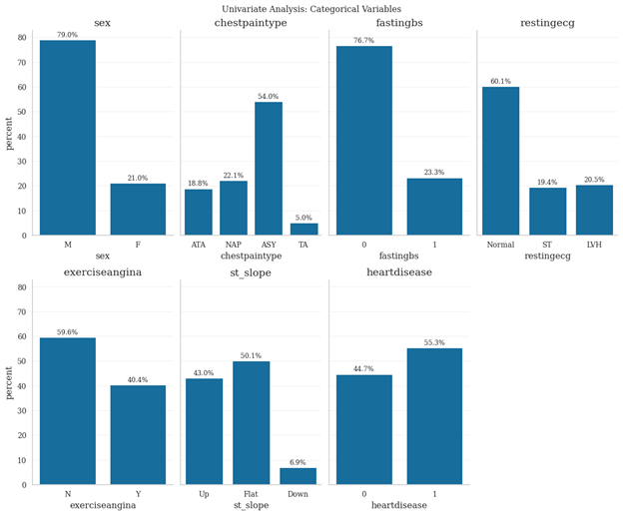
Univariate Analysis - Categorical Variables
variable | count | unique | Top value | frequency
sex | 918 | 2 | M | 725
chestpaintype | 918 | 4 | ASY | 496
restingecg | 918 | 3 | Normal | 552
exerciseangina | 918 | 2 | N | 547
st_slope | 918 | 3 | Flat | 460

Slide 6
Key Points:
Gender imbalance evident with male patients comprising 79% of dataset, with males showing substantially higher heart disease prevalence consistent with epidemiological patterns
Asymptomatic chest pain presentations dominate at 54% of cases, followed by non-anginal pain (22.1%), atypical angina (18.8%), and typical angina (5%)
ST-segment slope characteristics show flat patterns in 50.1% of cases, upsloping in 43%, and downsloping in 6.9% of observations
Exercise-induced angina present in 40.4% of patients, representing an important clinical indicator of cardiovascular stress
Resting electrocardiogram results indicate normal findings in 60.1% of patients, ST-T wave abnormalities in 19.4%, and left ventricular hypertrophy in 20.5%

Slide 7
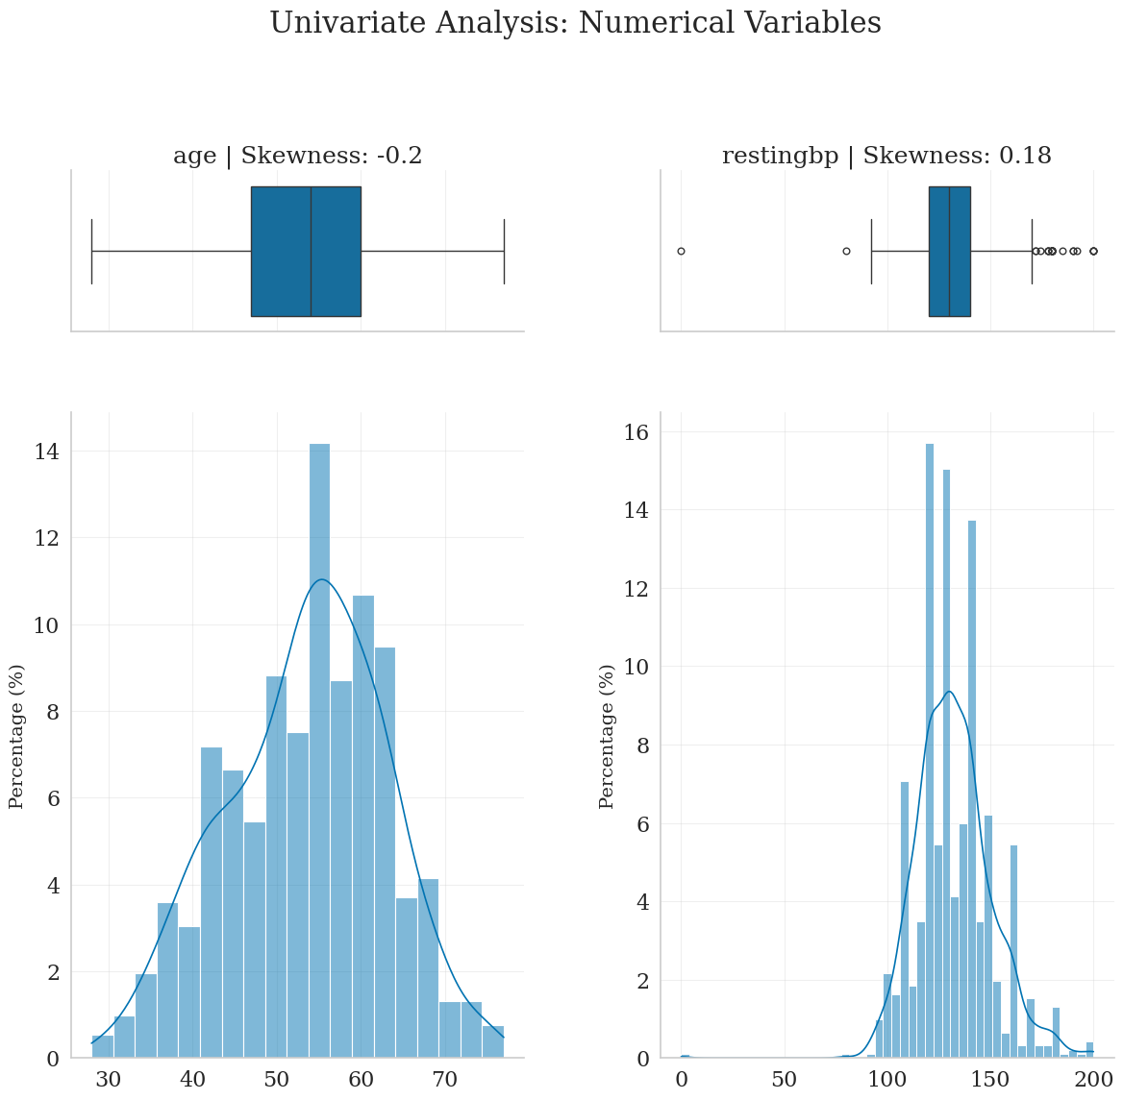
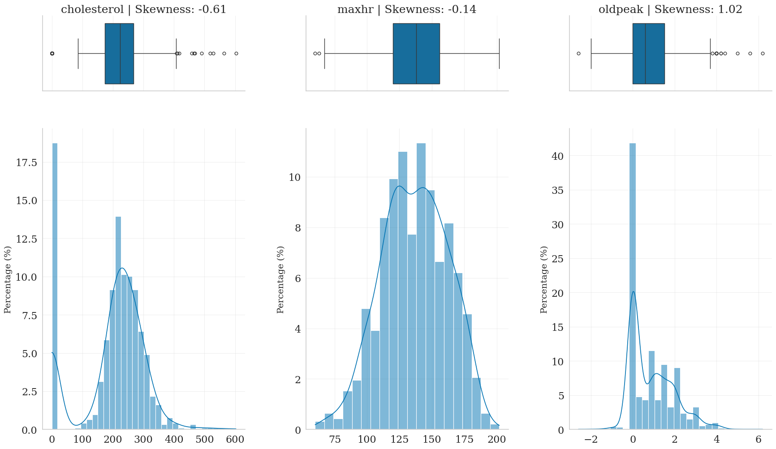
Univariate Analysis - Numerical Variables
right skewness with concentration between 50-60 years
high variance and right skewness with range 0-603 mg/dL, with zero values indicating missing data requiring imputation
strong right skewness with range -2.6 to 6.2, indicating small subset of patients with significant ST during exercise

Slide 8
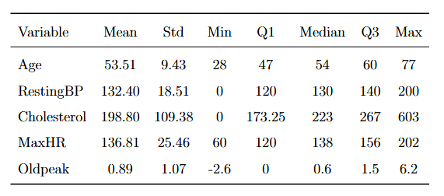
Numerical Variables – Summary Statistics

Slide 9
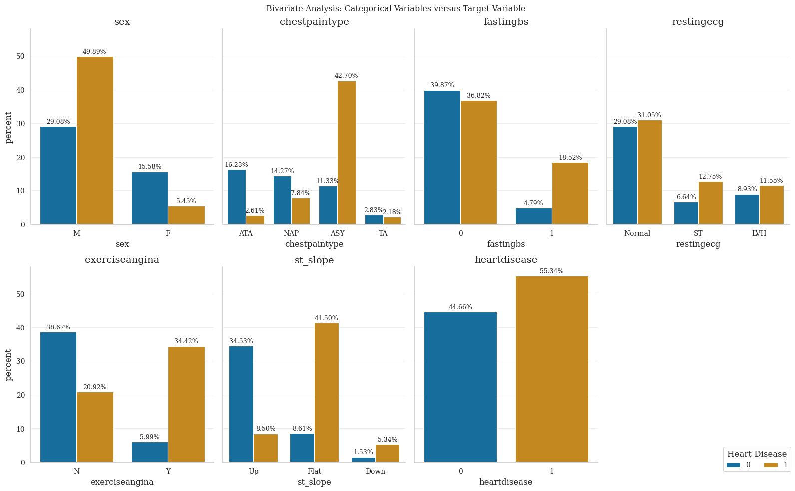
Bivariate Analysis - Categorical Features
Sex: Heart disease cases predominantly male (≈50%), females represent a much smaller proportion (≈6%), indicating a strong sex-related disparity.
Chest Pain Type: Asymptomatic (ASY) presentations dominate heart disease cases (≈43%) but are uncommon in non-disease cases. In contrast, ATA and NAP are more frequent among patients without heart disease.
Fasting Blood Sugar: Elevated fasting blood sugar (FastingBS = 1) is more common in heart disease cases (≈19%) than in non-disease cases (≈5%), suggesting metabolic risk.
Resting ECG: Normal ECG findings are common in both groups, while abnormal patterns occur more frequently among heart disease patients, though with weaker separation than other features.

Slide 10
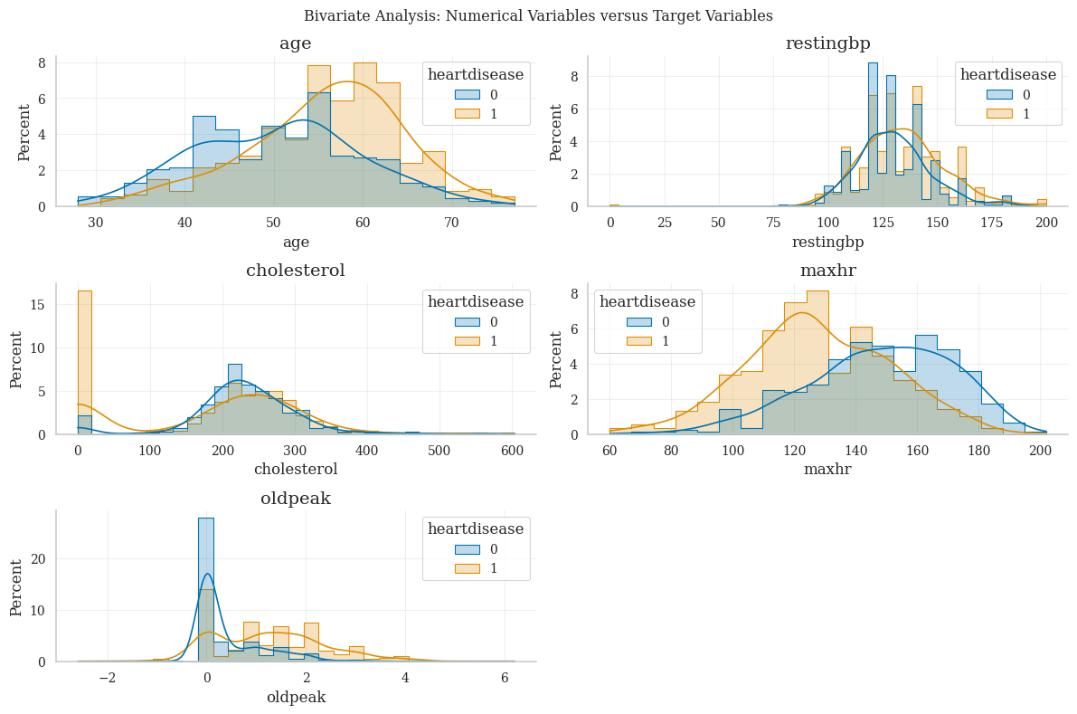
Bivariate Analysis - Numerical Features
Age: Heart disease patients are noticeably older, with peak density around 58–62 years, while non-disease cases cluster around 48–52 years.
Resting Blood Pressure: Slightly higher values are observed among heart disease patients, but substantial overlap limits its discriminative power.
Cholesterol: After removing zero values, both groups show similar distributions (≈200–250 mg/dL), indicating weak standalone predictive value.
Max Heart Rate (MaxHR): Strong inverse relationship—non-disease patients peak at higher heart rates (≈150–165 bpm), while heart disease cases peak lower (≈120–135 bpm).
Oldpeak: Exhibits the clearest separation; non-disease patients cluster near 0, whereas heart disease patients show higher and more dispersed values (≈1.0–2.5+).

Slide 11
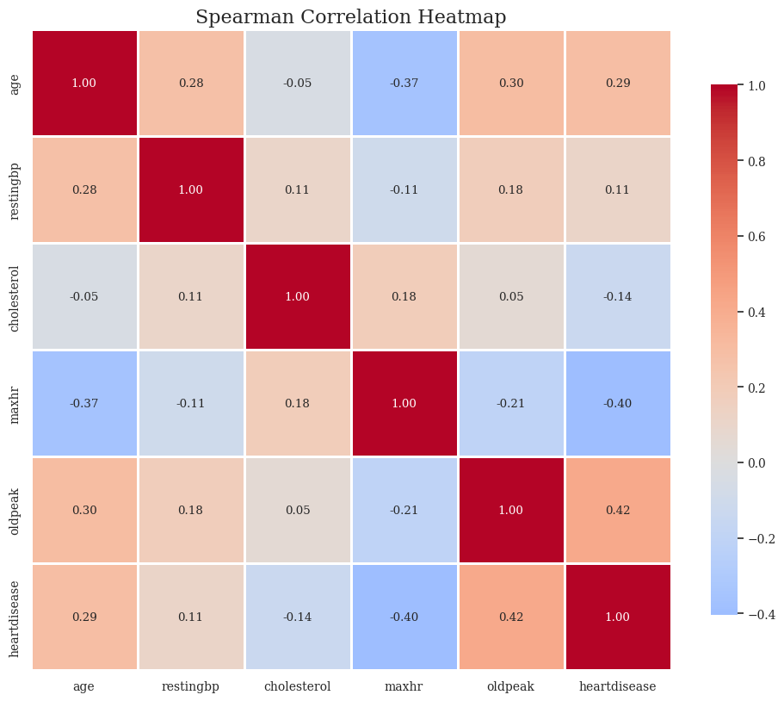
Correlation Analysis
Spearman correlation employed instead of Pearson due to non-normal distributions, heavy tails, and presence of outliers in variables
Oldpeak shows moderate positive correlation with heart disease (r = 0.42), representing strongest numerical predictor relationship
Maximum heart rate demonstrates moderate negative correlation with disease (r = -0.40), indicating inverse relationship with disease presence
Age exhibits moderate positive correlation (r = 0.29) with heart disease, confirming age as compounding risk factor
Cholesterol and resting blood pressure show weak correlations with target variable, suggesting limited standalone predictive value despite clinical importance

Slide 12
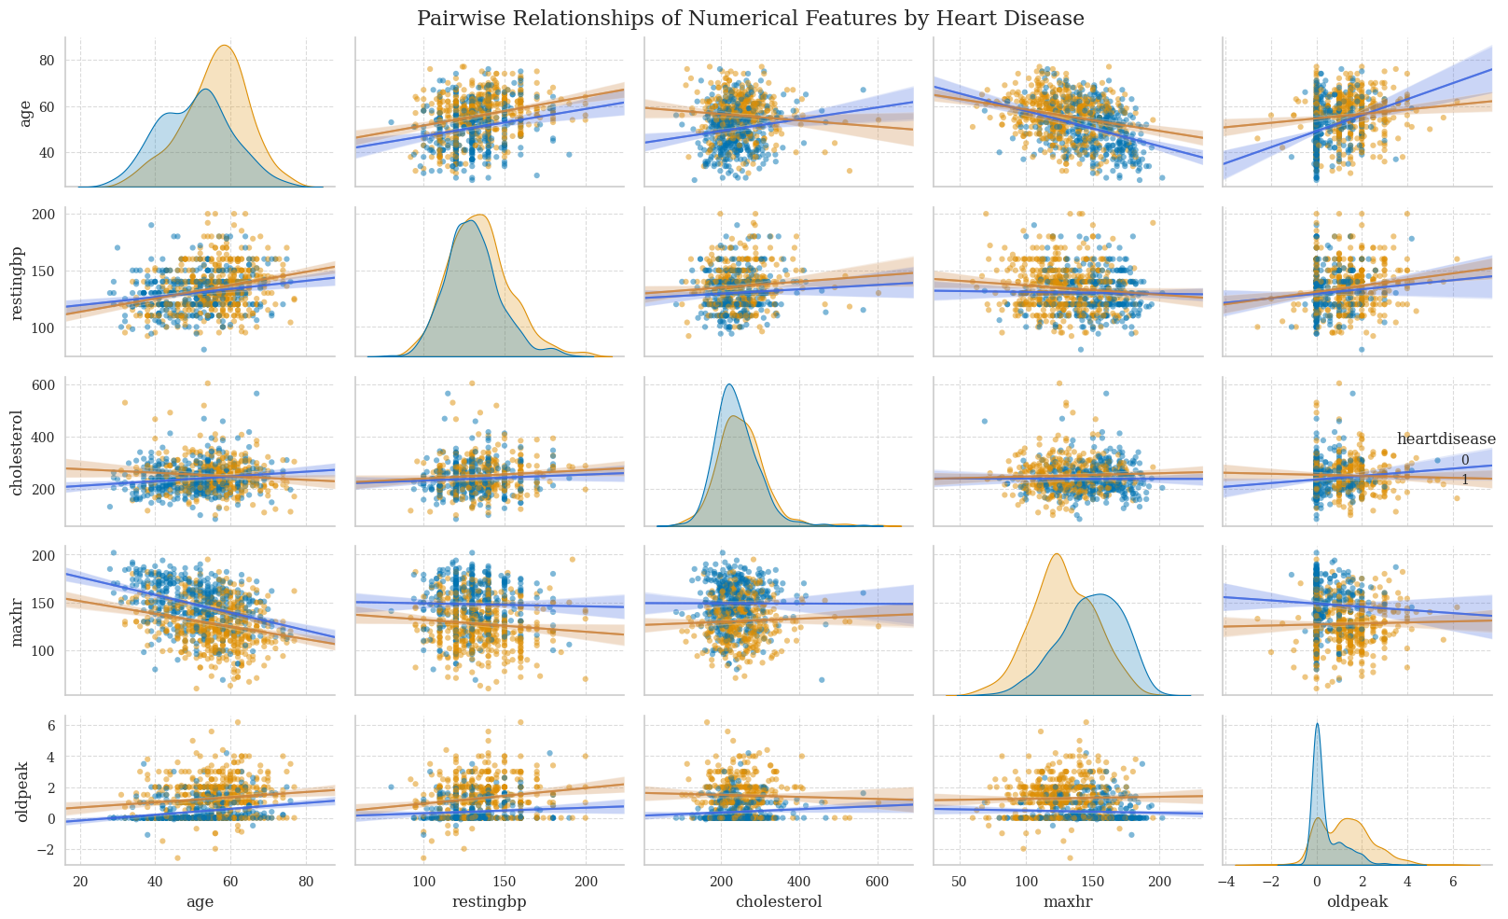
Pairplot Analysis: Numerical Feature Relationships
Distributional Shifts: Heart disease patients tend to be older, have higher Oldpeak, and lower MaxHR, while RestingBP and Cholesterol show substantial overlap across classes.
Age as a Compounding Factor: Age is positively associated with RestingBP and Oldpeak, and negatively associated with MaxHR, indicating declining exercise capacity and increased ischemic burden with age.
MaxHR & Oldpeak Interaction: Heart disease cases cluster at lower MaxHR and higher Oldpeak, forming a distinct pattern absent in non-disease patients.
Cholesterol: Exhibits weak pairwise relationships and high dispersion, suggesting limited standalone discriminative power.
Overall Insight: Strong separation arises from interactions among Age, MaxHR, and Oldpeak, supporting multivariate and non-linear modeling over simple univariate thresholds.

Slide 13
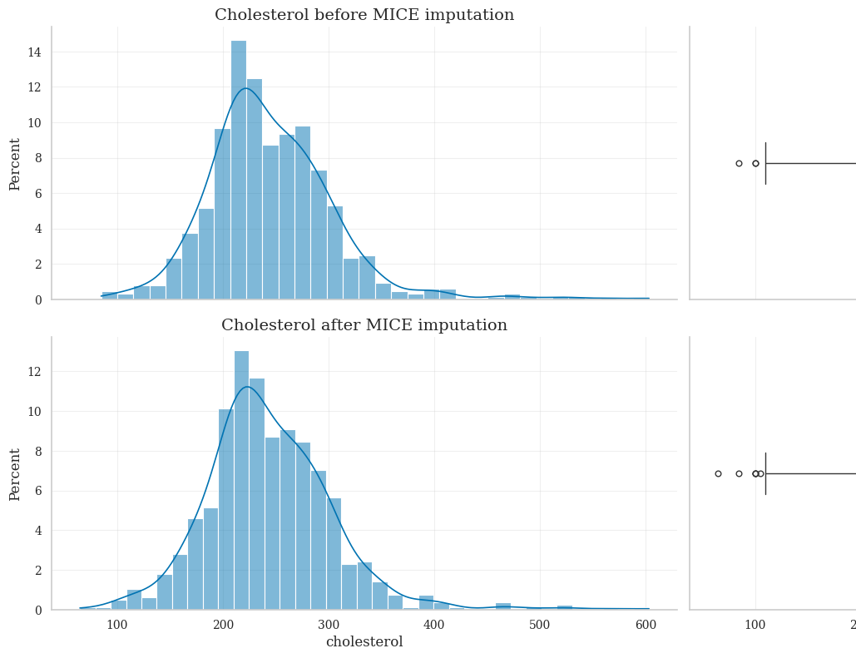
MICE Imputation Implementation
Multivariate Imputation by Chained Equations (MICE) selected as principled imputation strategy
Implementation utilized iterative imputer with maximum 20 iterations and posterior sampling enabled to reflect imputation uncertainty
feature | mean_before | mean_after | mean_delta (Δ) | std_before | std_after | std_delta (Δ)
cholesterol | 245.408736 | 243.882645 | -1.526091 | 60.209931 | 60.390708 | 0.180777
restingbp | 132.660256 | 132.660256 | 0.000000 | 18.719570 | 18.719570 | 0.000000

Slide 14
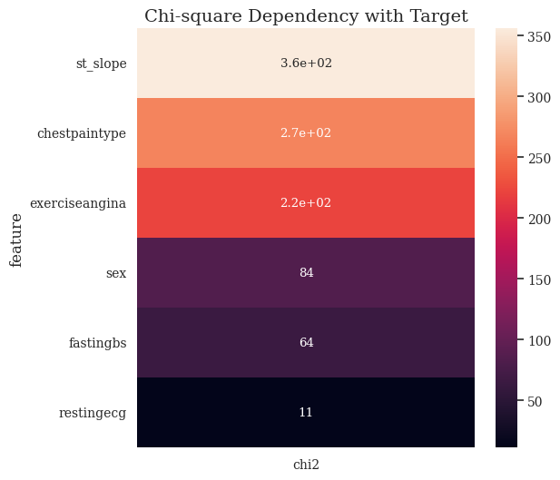
Feature Selection - Categorical Variables
Chi-square results: ST Slope shows the strongest dependency with heart disease (χ² ≈ 360), followed by ChestPainType (χ² ≈ 270) and ExerciseAngina (χ² ≈ 220).
Moderate associations: Sex (V = 0.30) and FastingBS (V = 0.26) contribute weaker but meaningful information.
Weak predictor: RestingECG and FastingBS shows minimal association indicating limited standalone value.

Slide 15
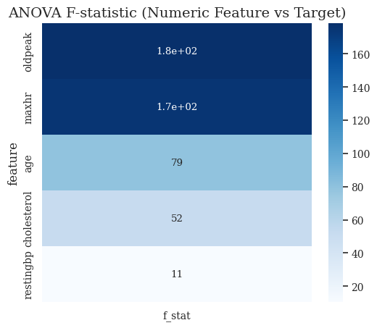
Feature Selection - Numerical Variables
One-way ANOVA F-tests evaluated whether mean values differ significantly between heart disease and non-heart disease groups
Oldpeak and MaxHR exhibit highest F-statistics (F ≈ 180 and F ≈ 170 respectively), indicating strong separation between outcome classes
Age demonstrates moderate F-statistic (F ≈ 79) while Cholesterol shows weaker effect (F ≈ 52) despite clinical relevanceRestingBP yields lowest F-statistic (F ≈ 11), suggesting limited discriminatory ability when considered in isolation
Final feature set removes restingbp

Slide 16
Data Preprocessing Pipeline
Stratified split allocated 85% to training (780 observations) and 15% to test set (138 observations) preserving class distribution
One-hot encoding applied to nominal variables (RestingECG, ChestPainType) without intrinsic ordering to create binary indicator variables
Ordinal encoding used for ST Slope with natural clinical ordering mapped to increasing risk severity (Down=0, Flat=1, Up=2)
Binary encoding implemented for ExerciseAngina (Y=1, N=0) and label encoding for Sex to ensure consistent category-to-integer mapping
Feature scaling applied using z-score normalization for continuous numerical variables while binary and encoded categorical features remained unscaled

Slide 17
Model Development Strategy
Three ensemble methods evaluated: Random Forest, Gradient Boosting, and CatBoost for binary heart disease classification
All algorithms make no distributional assumptions about predictors, accommodating non-normal distributions identified during exploratory analysis

Slide 18
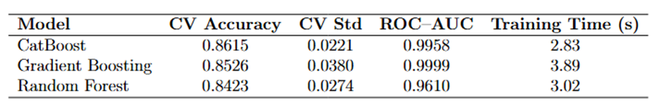
Model Performance Comparison: Training
Notes:
CatBoost achieved highest cross-validation accuracy (0.8615) with lowest standard deviation (0.0221) and ROC-AUC of 0.9958 Gradient Boosting demonstrated strong performance with CV accuracy of 0.8526 (SD 0.0380) and near-perfect ROC-AUC of 0.9999 Random Forest showed CV accuracy of 0.8423 (SD 0.0274) with ROC-AUC of 0.9610, indicating robust but slightly lower discrimination CatBoost completed training in 2.83 seconds, offering best balance between accuracy, stability, and computational efficiency All models substantially outperformed random baseline with ROC curves lying well above diagonal, confirming strong discriminative capability

Slide 19
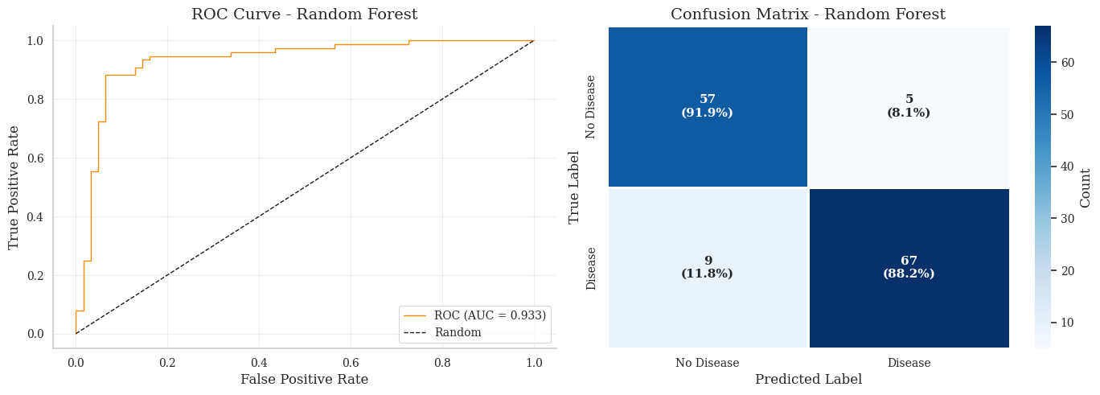
Confusion Matrix Analysis and Error Patterns: Random Forest

Slide 20
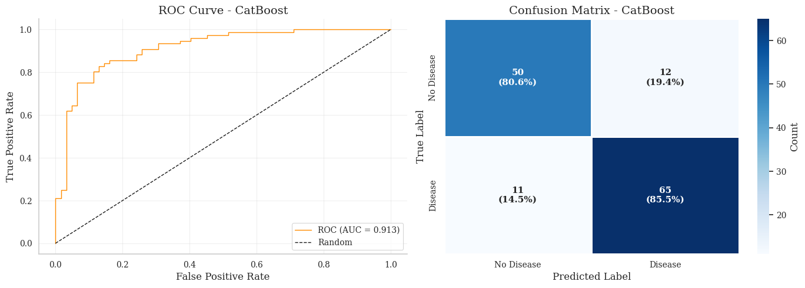
Confusion Matrix Analysis and Error Patterns: Random Forest

Slide 21
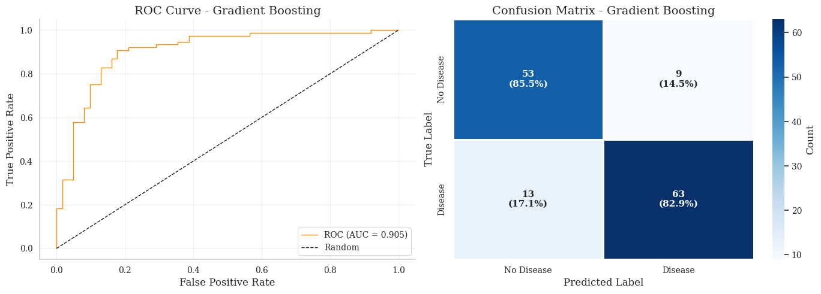
Confusion Matrix Analysis and Error Patterns: Gradient Boosting

Slide 22
Key Finding
Comprehensive exploratory analysis identified ST Slope, chest pain type, exercise angina, oldpeak, maximum heart rate, and age as strongest predictors
MICE imputation successfully handled missing data under MAR assumption, preserving distributional properties and multivariate relationships
CatBoost emerged as optimal model with 86.15% cross-validation accuracy and 0.9958 ROC-AUC, demonstrating excellent discrimination
Methodological rigor throughout all phases ensures robust, reproducible analysis generating trustworthy results suitable for clinical decision support

